Slide 1
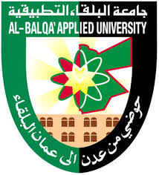
Al – Balqa Applied University
BAU
P 7– INNOLEA
INNOLEA KICK-OFF MEETING
14 – 15 December 2017
Jordan

Slide 2
University Overview
Vision
Colleges
Programs
ERASMUS Projects

Slide 3
University Overview
In accordance with a Royal Decree issued on 22nd August/ 1996, Al Balqa Applied University was established. It started teaching in 1997/1998 to overarch community colleges before which they had been merely scattered all over the kingdom.
Provides applied education, especially in engineering programs
Offers Master, Bachelor, Diploma, and Higher Vocational Diploma Programs

Slide 4
University Overview
13 campuses
+1424 Lecturer
+40,762 Students
+111,281
graduates

Slide 5
University Overview
Recognized by:
Council of Higher Education in Jordan
Association of Arab Universities
International Association of Universities
International Academic Commissions

Slide 6
Vision
Platform for quality Higher Education to cater market's needs on all levels: Diploma, Undergraduate, and Graduate
Applied implementation of various academic programs, including orienting research towards the development of local communities

Slide 7
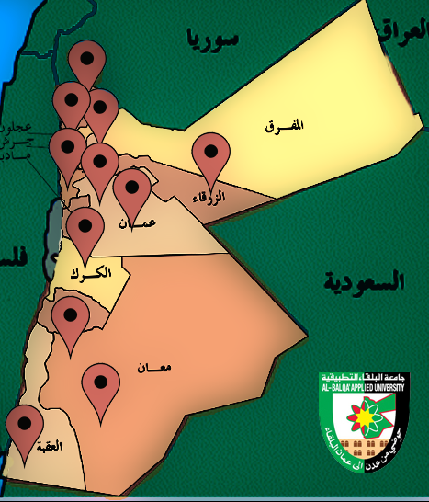
Colleges
BAU has 21colleges all around Jordanian governorates and cities (9 at main campus in Al-Salt city)
BAU supervises all 41 community colleges in Jordan (16 public colleges, 17 private colleges, 6 military colleges, and 2 UNRWA colleges)

Slide 8
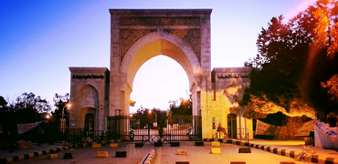
Colleges
Center Colleges:
Faculty of Graduate Studies
Faculty of Engineering
Faculty of Medicine
Faculty Prince Abdullah bin Ghazi for Information Technology
Faculty of Science
Faculty of Agricultural Technology
Faculty of Business
Salt College for Human Sciences
Salt Technical College

Slide 9
Colleges
External Colleges:
Zarka University College
Princess Rahma University College
Karak University College
Shobak University College
Maan University College
Aqaba University College
Huson University College
Irbid University College
Ajloun University College
Faculty of Engineering Technology
Amman University College for Banking and Financial Sciences
Princess Alia University College

Slide 10
Programs

Slide 11
ERASMUS + Funded Projects
Modernization of institutional management of innovation and research in South Neighboring Countries
Developing skills in the field of integrated energy planning in Med Land Scapes
Master curriculum, capacity building and network development in traffic safety in Egypt, Jordan and Lebanon
New Jordanian MSc in Water Management and Desalination Engineering (JoMDE)

Slide 12
ERASMUS + Funded Projects
Vocational training center for students and teachers in the Jordanian Universities
Fostering academia-industry collaboration in food safety and quality
Innovation for the leather industry in Jordan and Egypt

Slide 13
Thank you!

